Slide 1
FIFA Player Recommender Model
Abdulaziz Bardi

Slide 2
Introduction
The Goal:
Use the K-nearest neighbor model to recommend similar players in order to help team managers to determine the best players to buy to improve the team.
Classify players based on position classes.
Doing analysis and data manipulation to make the dataset better to read and understand as well as organizing the dataset.

Slide 3
K-Nearest Neighbors (KNN) Algorithm
K-nearest neighbors algorithm can used for classification and regression.
It was used as an unsupervised learning algorithm.
It works by finding distance between a query and data samples, and selecting the specified number of (K) closest to the query based on specified attributes.

Slide 4
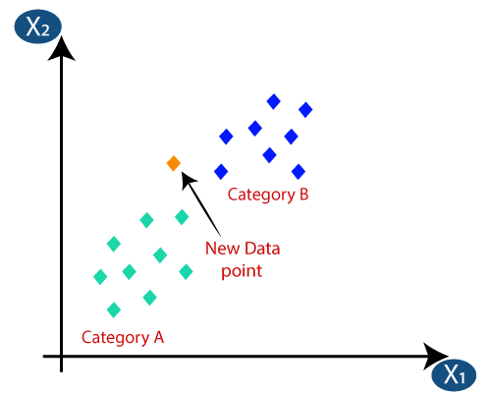
K-Nearest Neighbors (KNN) Classifier
It classify players by finding distance between a query and data samples, and selecting the specified number of (K) closest to the query.

Slide 5
Naïve Bayes (NB) Classifier
It is a simple probabilistic classifier based on Bayes Theorem.
It classify players by calculating the probability of each player by class which he might belong to.

Slide 6
Data
Dataset contains 17,305 rows with 93 features.
9 Categorical features
Drop 47 unneeded features, remaining 46 features
Example features: ID, Nick_name, Overall_rating, League_name, Nationality_name, Player_position, Age, Height_cm, Weight_kg, Preferred_foot, Weak_foot, Skill_moves, Body_type, Pace, Shooting, Passing, Dribbling, Defending, Physicality.

Slide 7
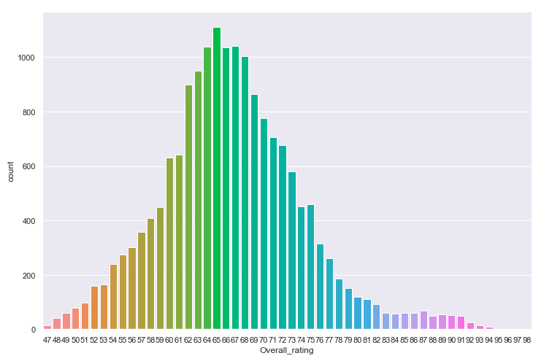
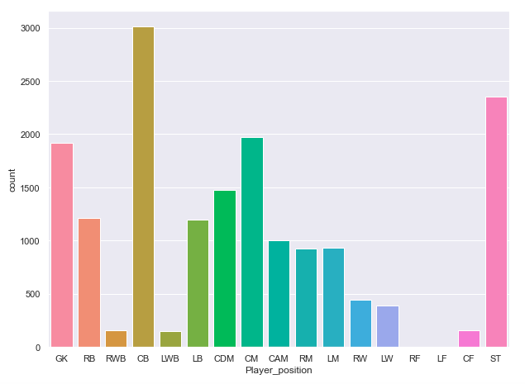
Data Con.

Slide 8
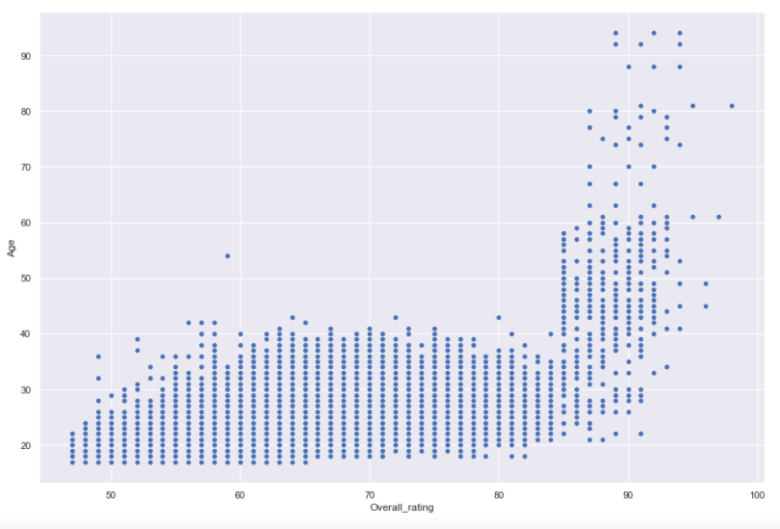
Data Con.

Slide 9
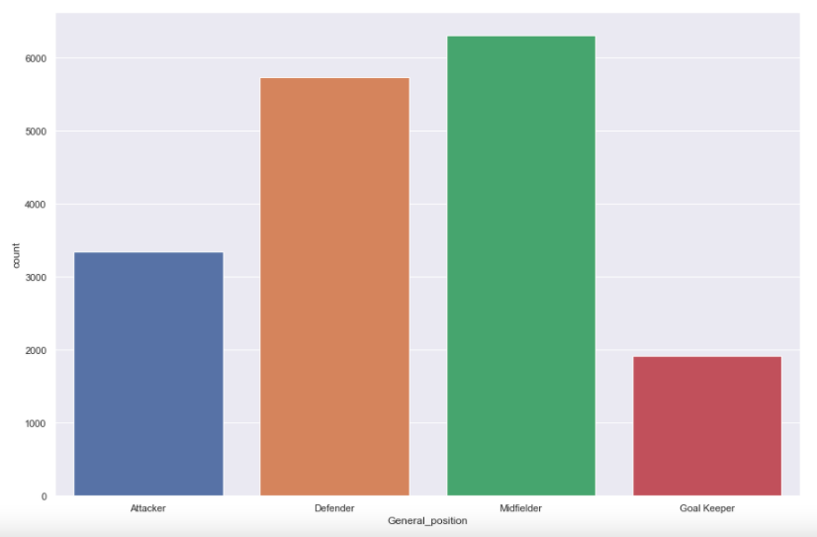
Data Con.
Positions Classes which classify player to these 4 classes.

Slide 10
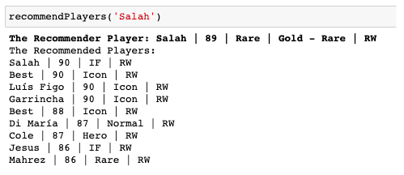
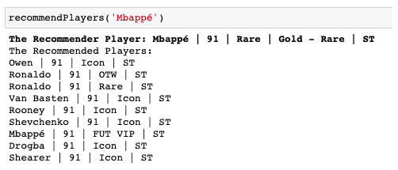
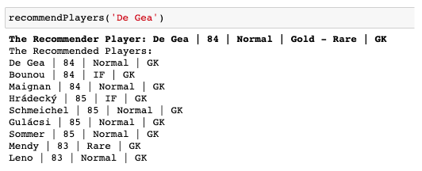
Recommender Model Results

Slide 11




K-Nearest Neighbors (Knn) vs Naïve Bayes (NB)

Slide 12
Tools
Data Manipulation and EDA: Pandas and Numpy
Visualization: Matplotlib and Seaborn
Modeling: Scikit Learn

Slide 13
Thank you for your time

